Slide 1
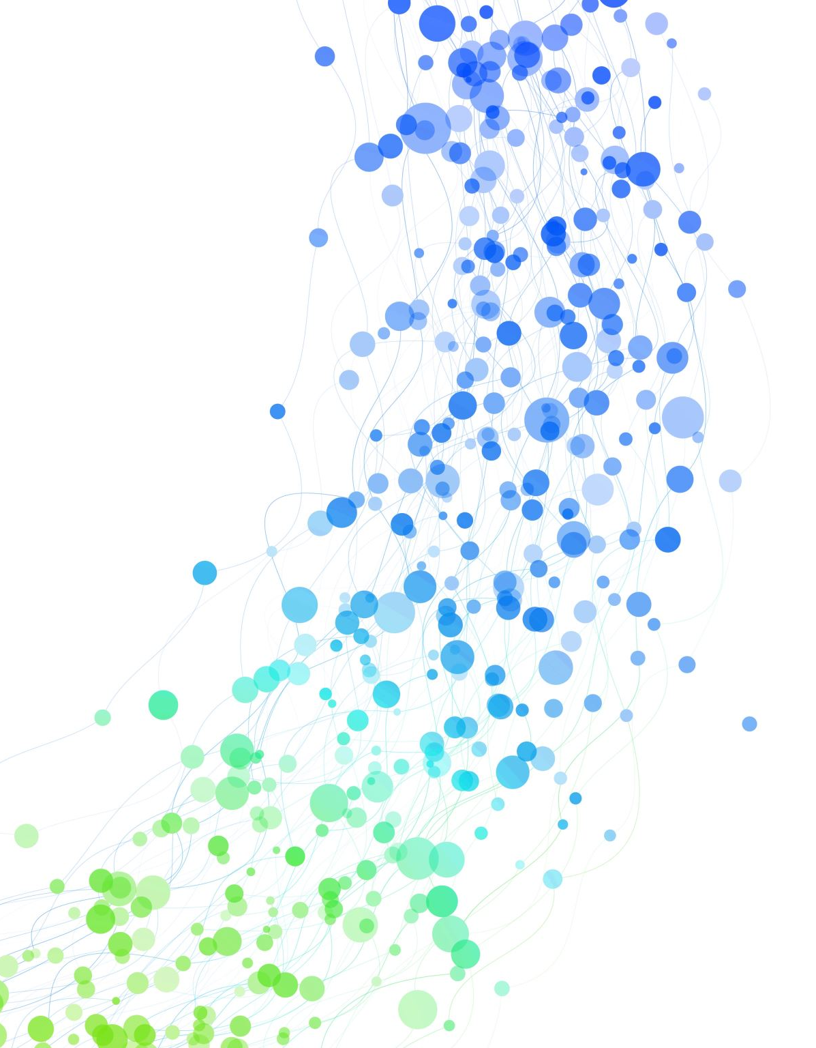
Individual driver model / Social Force Modeling
Complex Social Systems
Anastasia Psarou
Summer Semester 2024-2025

Slide 2

Intelligent Driver Model (IDM)
IDM is a continuous microscopic single-lane car-following model used to simulate how human drivers adjust their speed based on the vehicles in front.
Parameters of the model:
Desired velocity $u_{o}$.
Safe time headway $T$, the amount of time a driver wants to maintain between themselves and the vehicle in front.
Maximum acceleration α.
Desired deceleration $b$.
Acceleration exponent δ.
Jam distance $s_{0}$, minimum spacing between two vehicles when at standstill.
Vehicle length $l= \frac{1}{ρ_{max}}$.
Treiber, M., Hennecke, A., & Helbing, D. (2000). Congested traffic states in empirical observations and microscopic simulations. arXiv. https://arxiv.org/abs/cond-mat/0002177

Slide 3

Intelligent Driver Model (IDM) – Model equations
The acceleration assumed in the IDM is a continuous function of the velocity, the gap and the velocity difference (approaching rate) to the leading vehicle.
The acceleration is an interpolation between the tendency to accelerate on a free road and the tendency to brake when the vehicle comes too close to the vehicle in front.
Treiber, M., Hennecke, A., & Helbing, D. (2000). Congested traffic states in empirical observations and microscopic simulations. arXiv. https://arxiv.org/abs/cond-mat/0002177

Slide 4
Intelligent Driver Model (IDM) – Dynamic Single-Vehicle Properties
Equilibrium traffic. Any situation where traffic is smooth, steady, and unchanging (for a short time at least).
Acceleration to the desired velocity. If the traffic density is very low and the vehicle is going slower than its desired speed, then it can accelerate freely to reach the desired speed.
Breaking as a reaction to high approaching rates. When approaching slower or standing vehicles with sufficiently high approaching rates, even if the actual gap isn't tiny yet, the fact that you're approaching fast triggers the IDM to start breaking early.
Breaking in response to small gaps. This mode is active when the gap is smaller than the desired gap but there are no large velocity differences.
Treiber, M., Hennecke, A., & Helbing, D. (2000). Congested traffic states in empirical observations and microscopic simulations. arXiv. https://arxiv.org/abs/cond-mat/0002177

Slide 5
Social force model

Slide 6
Social force model
The motion of pedestrians can be described as they would be subject to social forces.
The forces:
A term describing the acceleration towards the desired velocity.
Terms reflecting that a pedestrian keeps a certain distance to other pedestrians and borders.
A term modeling attractive effects.
Helbing, D., & Molnár, P. (1995). Social force model for pedestrian dynamics. Physical Review E, 51(5), 4282–4286. https://doi.org/10.1103/PhysRevE.51.4282

Slide 7
Why is it important?
Applications like emergency simulation and urban planning of crowd simulation in video games and movies.
Development of mobile robots capable of navigating crowded human environments in a safe, efficient and socially appropriate manner.

Slide 8
PySocialForce
Forces for individuals:
The repulsive forces between pedestrians.
The attractive forces between each pedestrian and their goal(s).
The repulsive forces from obstacles.
Forces for groups:
The coherence force that holds group members together.
The repulsive force that keeps members from getting too close to each other.
A force calculated from the gaze directions of pedestrians to maintain group formations.
https://github.com/yuxiang-gao/PySocialForce

Slide 9
PySocialForce
To run an example the user should create a Simulator object where they should provide:
1
Initial states, positions, velocity and goals of the pedestrians
Optional information of social groups and obstacles.
After the simulation finishes, then the user can generate an animation of the simulator.
2

Slide 10
Simulator PySocialForce
Initial state:
Entry position x | Entry position y | Velocity x | Velocity y | Goal of the pedestrian x | Goal of the pedestrian y
Groups (if there is one):
Pedestrian 1 | Pedestrian 2
Obstacle (if there is one):
Xmin | Xmax | Ymin | ymax

